Slide 1


Slide 2

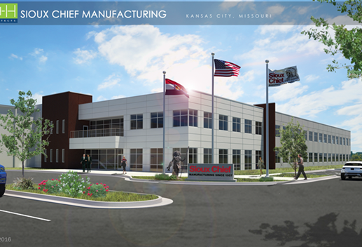
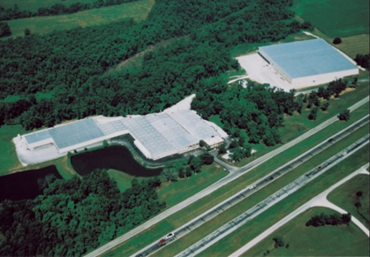
Family owned – Founded in 1957, Sioux Chief has been in business in the Kansas City area for over 60 years
Sioux Chief employs over 700 people
660,000 square feet of office space, distribution center, and manufacturing facility expansion in Kansas City, MO in 2017
Copper fabrication, PEX & vinyl tubing extrusion and special packaging remain in our 370,000 sf facility in Peculiar, Missourri
Over 1 Million square feet of manufacturing capacity

Slide 3
PRODUCTS THAT SIOUX CHIEF MANUFACTURES:
Water hammer arresters, pre-formed copper rough-plumbing fittings, Floor Sinks, Brackets & Supports, Floor Drains & Cleanouts, PEX Tubing & Fitting Systems, Full line Commercial Drainage Offering, Trap Primers, Closet Flanges, Access Boxes, Backwater Valves, Roof Drains, Trench Drains, P-Traps, Linear Shower Drains, Shower Drains, Air Admittance Valves, Closet Bolts, Tubular Specialty items, and more. The Following Pages Highlight Sioux Chief’s Most Popular Engineer Specified Products.

Slide 4
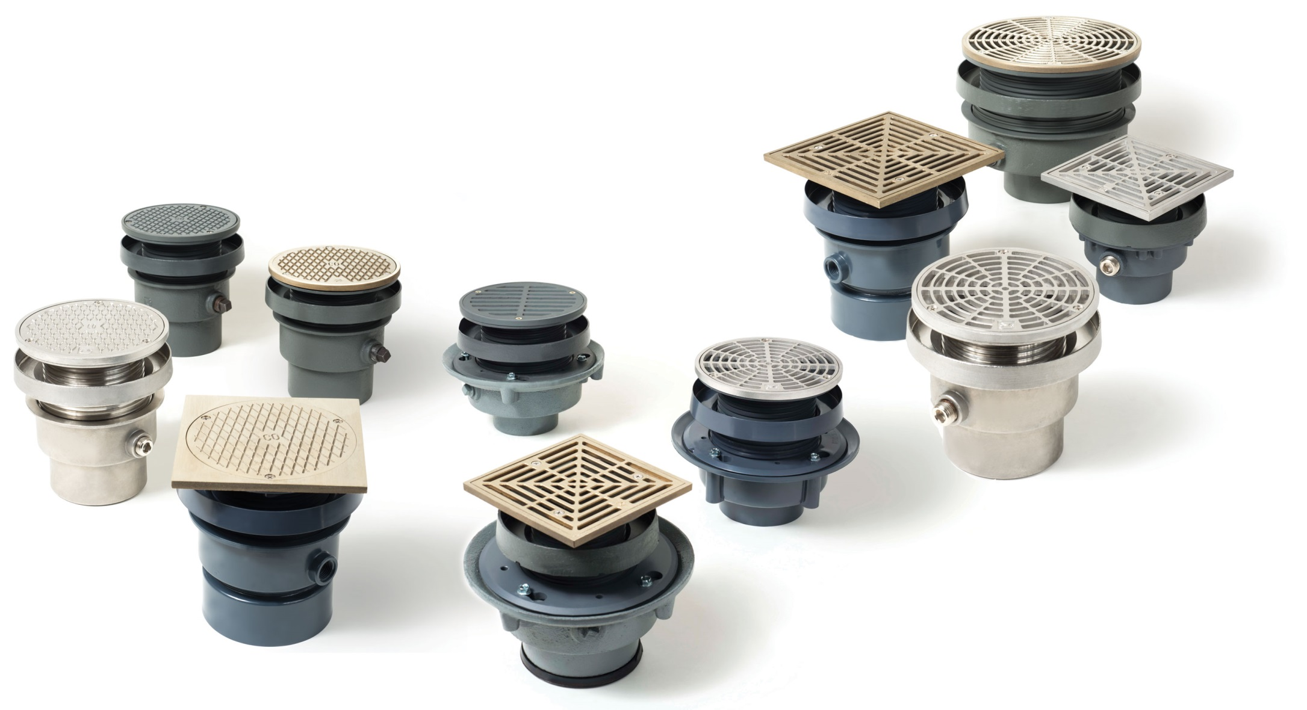

COMMERCIAL FLOOR DRAINS & CLEANOUTS
Notes:
SCM uses ductile-iron in-lieu of cast-iron for many our cast-iron products.
Ductile has higher tensile strength and is lighter weight.
Our ductile/cast-iron products should be considered as equals to competitive cast-iron products since in many cases, they come from the same metal forgers in Asia.
No need to “box out”.
“Acme” or square threads for added strength.

Slide 5
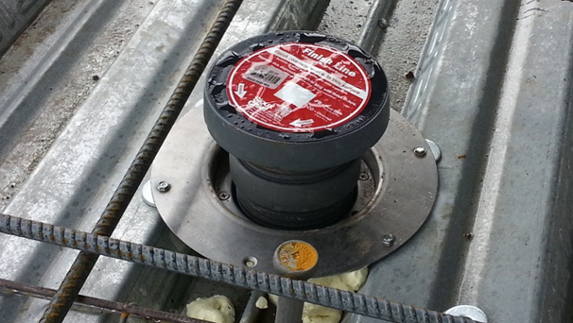
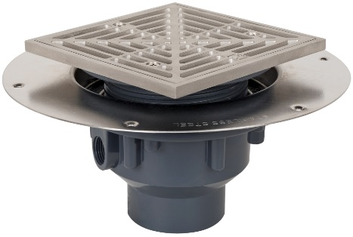
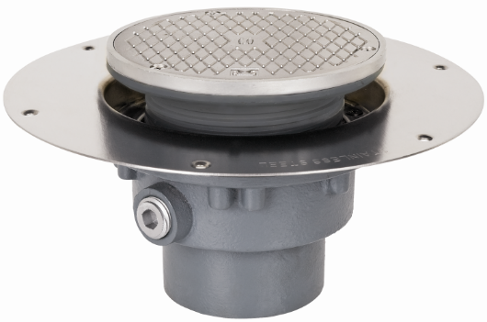
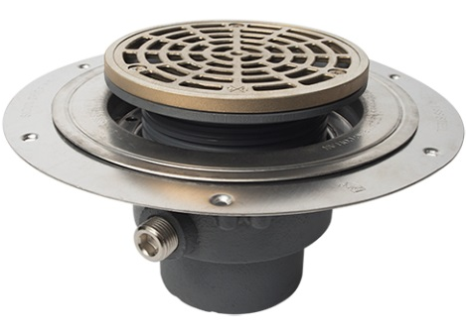
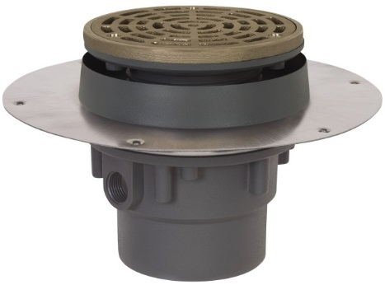
DECK DRAINS & DECK CLEANOUTS

Slide 6
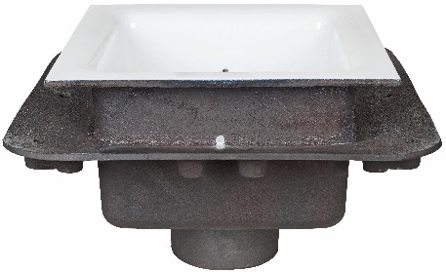
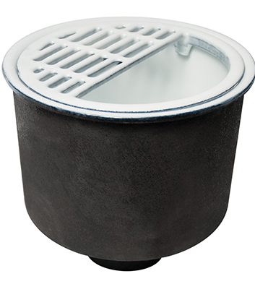
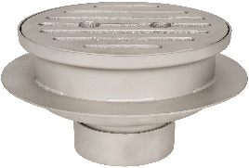
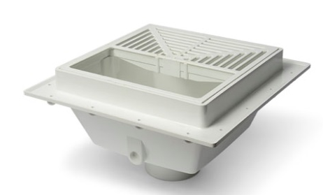
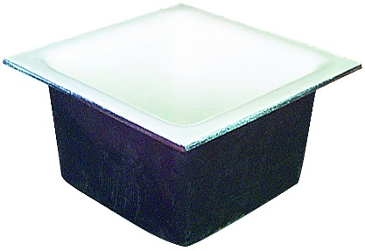
CAST IRON & PLASTIC FLOOR
SINKS

Slide 7
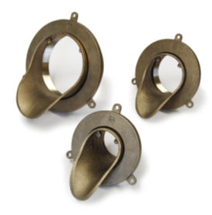
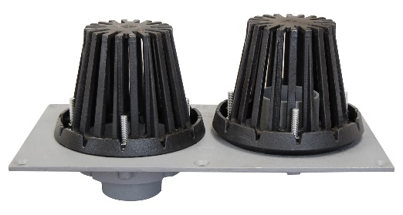
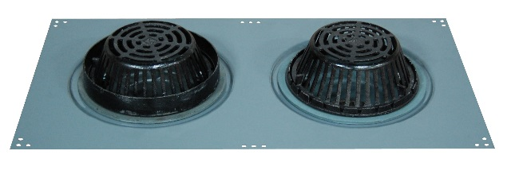
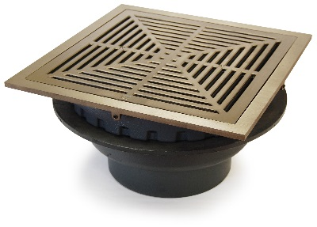
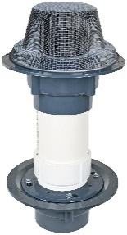
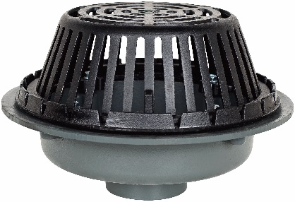
ROOF DRAINS

Slide 8
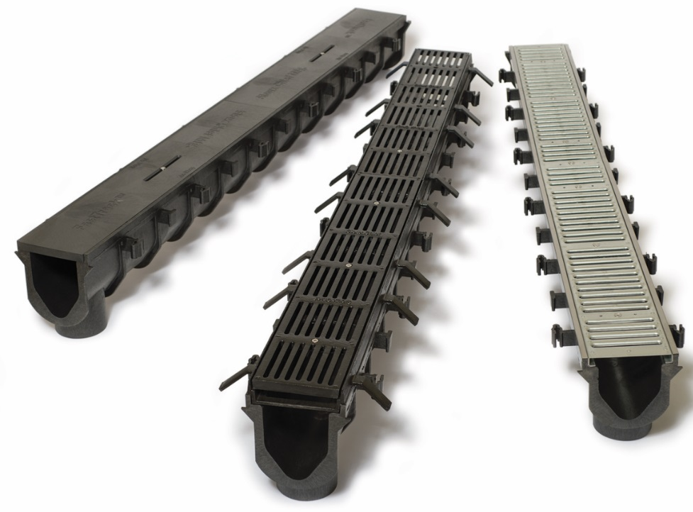
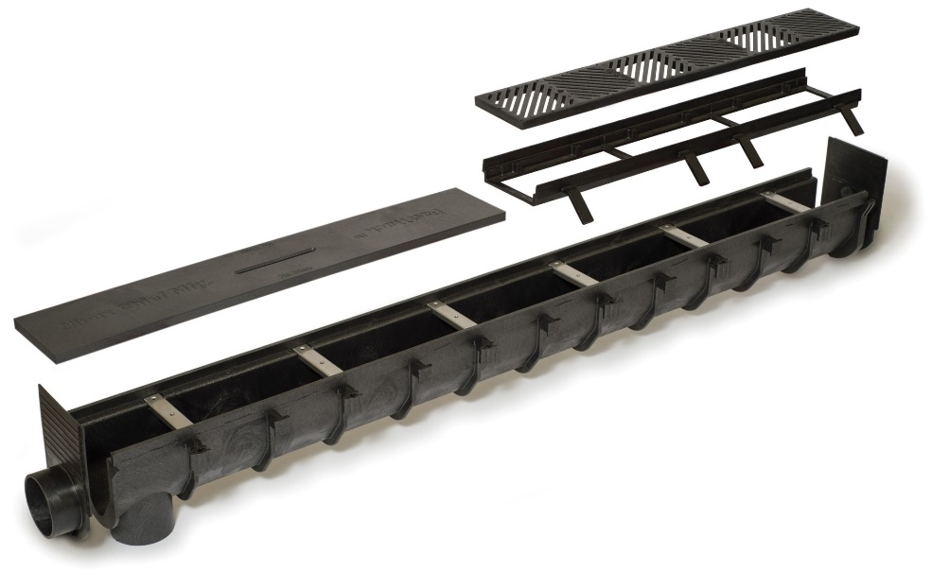
COMMERCIAL TRENCH DRAINS

Slide 9
Water Hammer Arresters

Slide 10
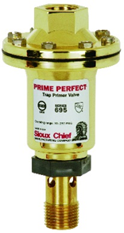
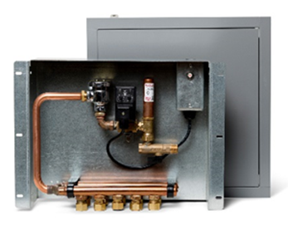
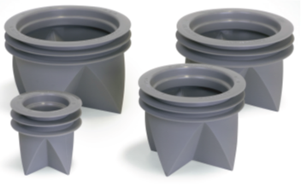
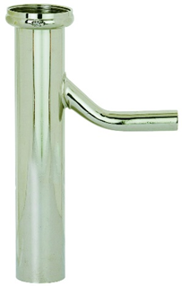
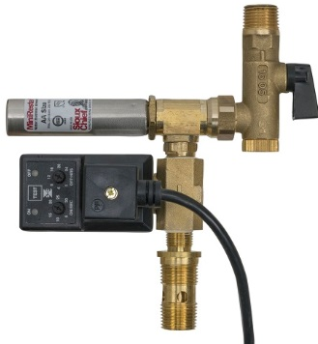
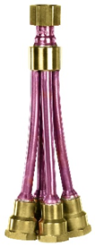
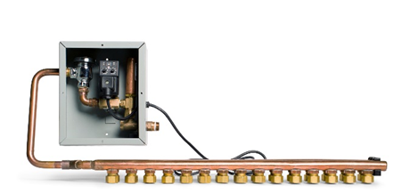
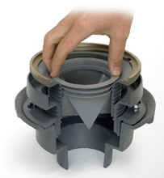
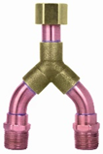
Trap Primer Devices

Slide 11
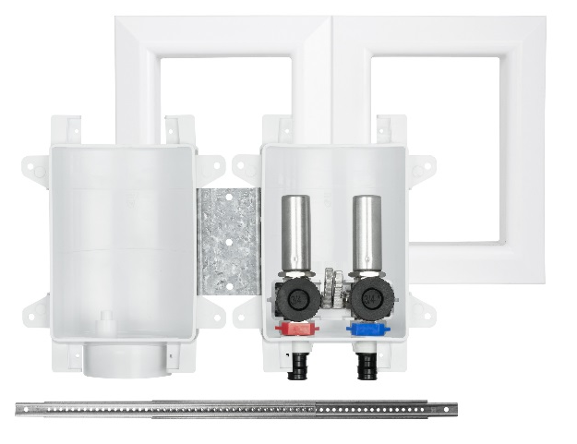
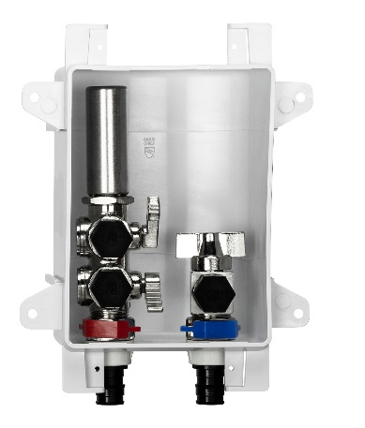
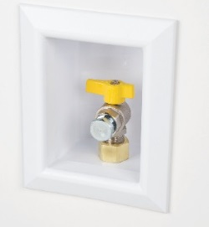
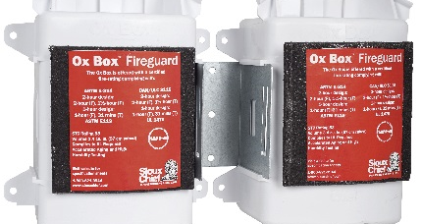
OUTLET BOXES
Notes:
Condensate Drain Box

Slide 12
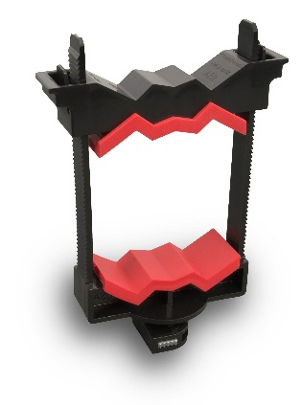
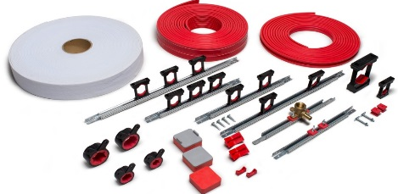
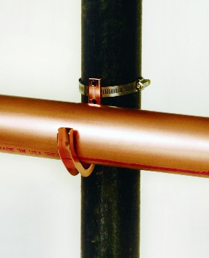
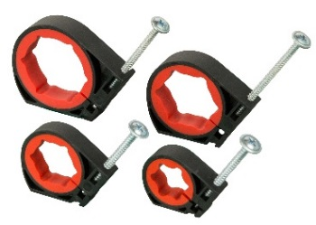
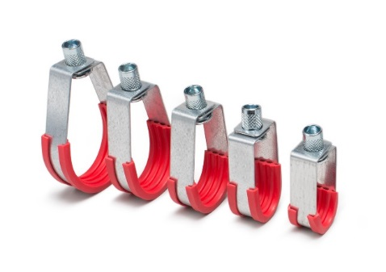
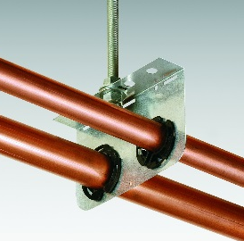
Commercial Hangers & Supports
Notes:
Backwater Valves
Shower Drains
PEX Tube
Manifolds
Access Panels
Hose Bibbs
Transition Adapters
Trim/Finish – Stops, P-traps, Escutcheons
Objection: “we don’t have everything the competition has”--- this is what we have today to get specified

Slide 13


Slide 14

There are nearly 7,000 items in the Sioux Chief Line.
Over 90% of them are proudly made in the USA.

Slide 15

Adjustable Drainage System
Solving Problems in Design, NOT in the Field

Slide 16
The Challenge:
Ensure the installation of floor drains and cleanouts that are perfectly level with the finish floor every time, and provide the client with a perfect finish.

Slide 17
Question:
Why does this need to be specified?
Why aren’t fixtures always set properly, free from damage, and flush with the finished floor?

Slide 18
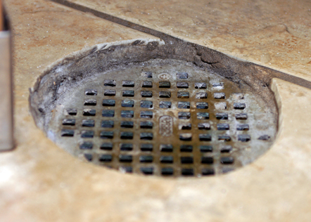
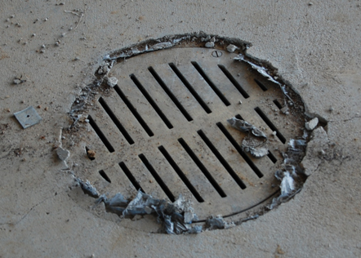
Common Issue: Low and Tilted Fixtures
Since the finish floor elevation is not apparent when drains are installed , fixtures that are set too low or tilted are a common occurrence

Slide 19
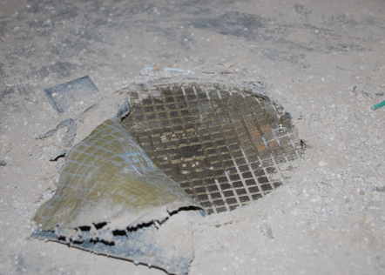
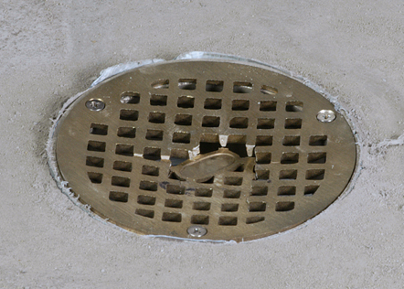
Common Issue: Strainer Tops that are Dished or Damaged During Construction
Scissor lifts, jobsite machinery, and other heavy equipment often dish or damage drains that are often only rated for pedestrian traffic

Slide 20
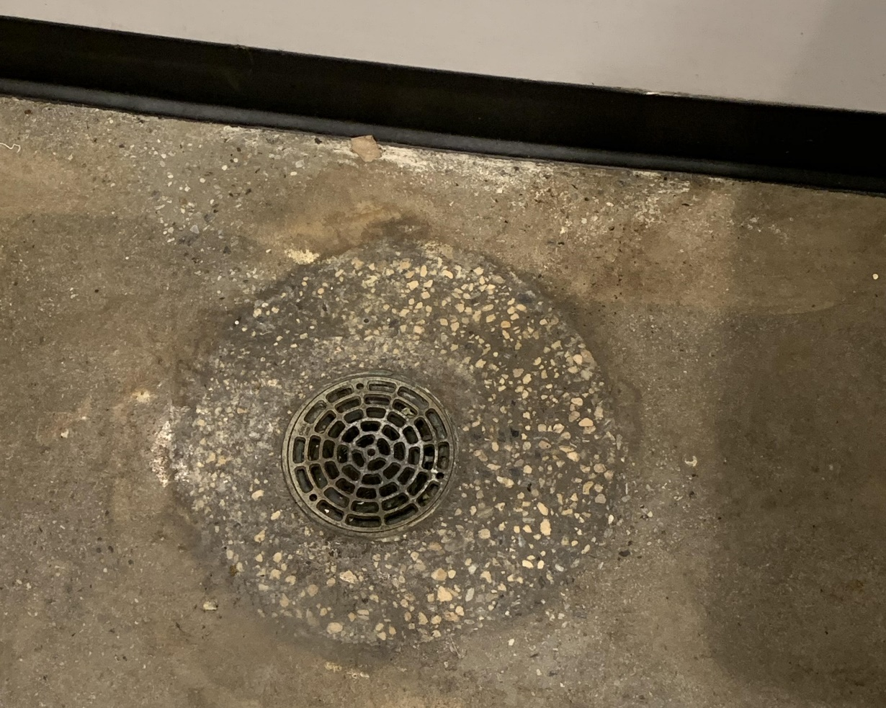
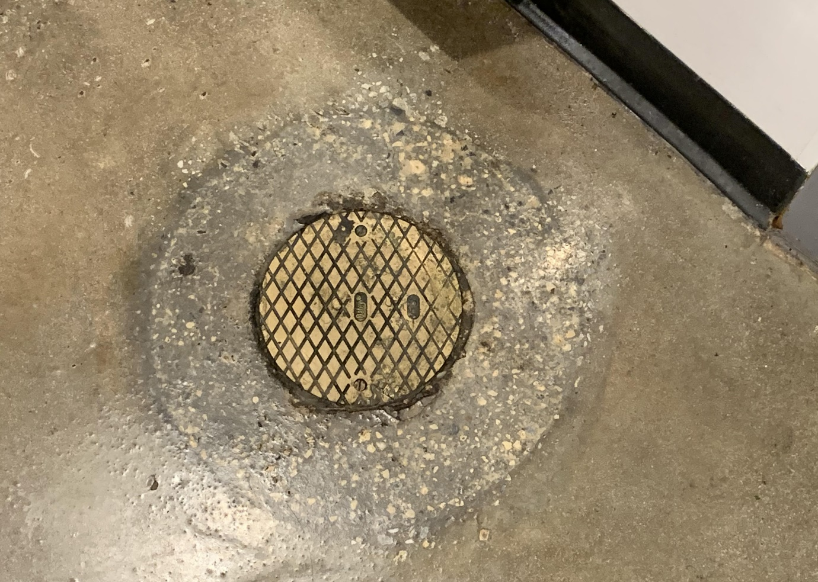
Common Issue: Stained, and polished concrete finishes are very popular
Although very popular, these poured concrete finishes require drains to be set perfectly. Contractors often box out these installations to assure strainer tops are level with the final floor. Unfortunately, boxing out on a stained or polished concrete finish produces an unsightly look.

Slide 21
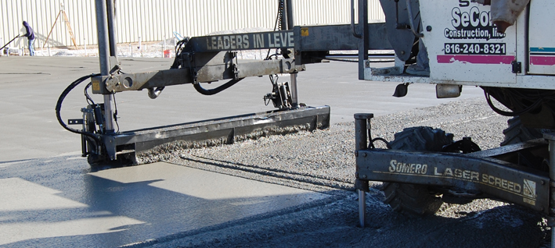
Potential Issue: Finishing Equipment
Mechanical slab finishing equipment, or tilt-up wall construction may not allow any protrusions in the slab

Slide 22
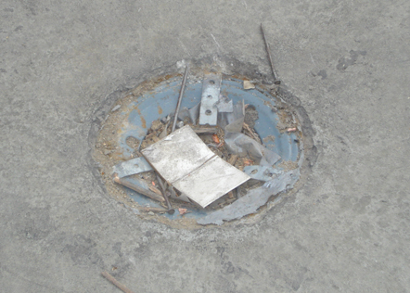
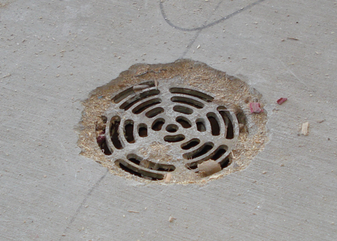
Potential Issue: Clogged Lines
Open, unprotected drains allow construction debris to collect and clog drain lines

Slide 23
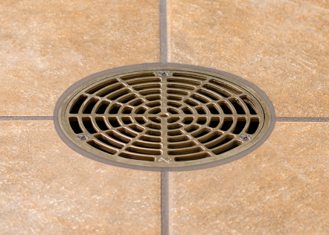

Potential Issue: Finished Flooring Change Orders
Clients change their selection of flooring style after fixtures are poured in – e.g. tile to stained concrete. This typically results in fixtures needing to be reset, a labor intensive and expensive proposition.

Slide 24



Typical Floor Drains & Cleanouts MUST be Protected During the Concrete Pour & Throughout Construction
Contractors regularly tell us that one of their top punch-list items is drains/cleanouts that are not level, tilted, or that have been dished out and damaged during construction

Slide 25
Question:
What can the Engineer do to completely eliminate these issues, and provide their client with floor drains and cleanouts that are perfectly level to the finished floor, and look brand new and perfect every time?

Slide 26
The Specification:
All floor drains and cleanouts shall be protected during construction, adjustable after the concrete pour, and level with the finished floor

Slide 27

Specifying the FinishLine Drainage system addresses common installation
issues in the design phase by allowing contractors to:
1. Protect Finish Fixtures from Construction Damage
2. Drains & Cleanouts EASILY Adjust AFTER the POUR
3. Tilted Drains & Cleanouts can EASILY be releveled AFTER the POUR

Slide 28


How Does Finish Line Differ from other Commercial Drains?
Typical commercial drain/cleanout

Slide 29



Slide 30



Slide 31




Keeping strainers off the jobsite until the final flooring is installed assures that the finished job gets brand new perfect strainer tops every time:

Slide 32

Installed in 2014
Picture Taken Feb. 2020
Still looks perfect after 5-6 years
1900 Building – Office & Event Space
Mission Woods, KS (Kansas City Metro Area)

Slide 33

Installed in 2014
Picture Taken Feb. 2020
Still looks perfect after 5-6 years
1900 Building – Office & Event Space
Mission Woods, KS (Kansas City Metro Area)

Slide 34



Slide 35
Adjustable Drainage System

Slide 36
DECK DRAINS & DECK CLEANOUTS

Slide 37




Floor Drains / Cleanouts with Stainless Steel Deck Flange

Slide 38

Unique & Adaptable
Adjustable head
Optional clamping collar
Strong stainless steel mounting flange
Integral o-ring seal between flange and body
ABS/PVC or cast iron body

Slide 39

Installation Versatility
Installs in cored concrete floors or Q-deck forms
FinishLine option allows for secondary pours and After the Pour adjustability
Installs in single 6” core, eliminating expensive two step coring

Slide 40

Installation Versatility
Installs easily from the Top Side of the floor into a single step 6-inch core
No labor intensive blocking-up from underneath

Slide 41
Installation Versatility
Head adjusts up to ¾” above flush
FinishLine models adjust AFTER the pour

Slide 42


Installation Versatility
Lenexa Civic Center - US Engineering

Slide 43



Unique & Adaptable
Floor
Drain
Great for loft remodels, second-floor utility/laundry rooms, multi-family construction, etc.
Models available with FinishLine feature
ABS/PVC body or cast iron body
Cleanout

Slide 44


Fixture Mounting & Connection Fitting
Anchors fixtures in place on slab form during rough-in
Rugged, one-piece ductile iron construction
Provides easy access to connection when form is removed

Slide 45


Fixture Mounting & Connection Fitting
Measure & Mount

Slide 46


Fixture Mounting & Connection Fitting
Pour & Connect

Slide 47


Current Method
Sioux Chief Solution
Labor intensive, and subject to drains being knocked out of level during the concrete pour
Consistent & Solid. Easy access to make connections after the pour

Slide 48




View from ceiling after wood form removed.
Glue 3” PVC pipe up into Drain Hub connection.
Attach Firestop Collar

Slide 49
FLOOR
SINKS

Slide 50




Large-capacity Floor Drains
Great for large floors or outdoor areas
A variety of options and accessories to suit numerous applications
ABS/PVC models with Sch. 40 hub connection
Cast iron models with No-hub or Push-Joint connection
Stainless Steel models for special applications

Slide 51



PVC Square Floor Sinks
A great alternative to cast iron sinks
Non-porous, bacteria/heat resistant and corrosion proof
A variety of options and accessories to suit numerous applications
Molded from our high-grade, impact resistant PVC for durability
Easier connection to Sch. 40 DWV
with stainless steel open-half strainer

Slide 52


Slide 53

TRENCH DRAINS
6-inch HDPE Trench Drain System

Slide 54



System Features
Tough, lightweight HDPE material
72" Sloped & neutral channel sections, 36” Grate sections
Easily field cut on 6” increments
Construction covers and grate anchors included
Pre-molded bottom outlet and rebar anchors
Solid, interlocking channel joints do not require fasteners

Slide 55


System Features
Iron grate frames for
Traffic rated jobs
Covers slide across joints
Quick-measure using ribs
Channel shape
improves flow
End outlet/cap fits all channels

Slide 56

Grating Options
Ductile Iron: Slotted, Cross-Slot, Diagonal-Slot patterns Heavy/Medium duty traffic applications
Galvanized/Stainless Steel: Slotted and Perforated patterns Medium/Light duty traffic applications
HDPE: Slotted pattern. Pedestrian/Light duty traffic, pool areas, chemical-resistance

Slide 57



Accessories
End cap/outlet: Attach with screws. 4” No-hub connection
Edge Guards: Covers channel edge for more finished look
Grate Frame: Protects channel from heavy load/impact damage

Slide 58


Job Sketch Sheets

Slide 60


Slide 61


Slide 62


Slide 63


Slide 64


New PEX Extrusion Lines - Sioux Chief Peculiar

Slide 65
ROOF DRAINS

Slide 66






CAST IRON ROOF DRAINS & ASSEMBLIES

Slide 67


HEAVY DUTY CLEANOUT HOUSING

Slide 68
Downspout Nozzle
Effective
Nozzles divert water away from the building wall to prevent unsightly water stains
Available in 3" – 8" sizes with No-Hub or FIP thread connection
Quality
Cast nickel-bronze material. Escutcheon/ring included to provide a clean, secure appearance

Slide 71


Water Hammer Arresters
Highest Quality
Best Warranty
Best Track Record
Most Widely Distributed Worldwide
Made In America
Made In America from Domestic Materials

Slide 72


Slide 73


Slide 74


Slide 75


Slide 76


Slide 77


Slide 78



Prime Perfect™
Trap Primer - Mechanical
Engineered Trap Seal Protection
Large Water Chamber will emit .25oz of water per activation = industry leading
Large screen and internal port will not clog
Made in the USA
Self-charges with water so it will not waterlog
Factory set for 60psi line pressure and field adjustable from 30-150psi
Wye & Splitters

Slide 80


Trap-Ease™
Trap Primer – Gravity fed
Engineered Trap Seal Protection
ASSE 1044 listed
Economical – most cost effective and maintenance-free installation solution
Made in the USA
Green – Uses ‘gray water’ to replenish traps

Slide 81



ETP™
Trap Primer - Electric
Engineered Trap Seal Protection
Available in recessed, surface mount or without access box solution
Integral debris screen protects solenoid valve from fouling
Integral shutoff and vacuum breaker – ASSE 1044 listed
Assembled in the USA
Duration of emission and frequency of emission can be set and tested

Slide 82



Slide 83

The most versatile outlet box in the industry for washers, icemakers, lavatories, dishwashers, toilets, AAVs, and gas connections
Strong: Over Stud application offers industry’s strongest installation
Fast: Installation times are cut in half
Flexible: Separate Boxes offer endless configuration options
Durable: ABS material stands up to the job site abuse
Approvals:
Standard packaged Ox Box kits are UPC Listed
Fire-Rated Ox Box Kits are Warnock Hersey Certified
Valves comply with ASME A112.18.1

Slide 84


Slide 85


Slide 86

Kitchen Supply Box
Three 3/8” O.D. Outlet Valves
Provides Valve Connection for Hot and Cold
lines of Kitchen Faucet
Third Valve Provides Hot Connection to
Dishwasher with Optional Arrester
Eliminates labor of cleaning stub outs and
installing supply stops

Slide 87



Slide 88


Outlet Boxes allow for a clean looking professional installation wherever a water or drainage outlet is needed

Slide 89


Condensate Outlet Box
Allows for flow rates up to 7 g.p.m.

Slide 90


Gas Valve Outlet Box

Slide 91

Lavatory installations are consistent, level, clean, solid, and professional ever time

Slide 92



Slide 93


Slide 94

Shower Drains

Slide 95


Shower Pan Drains
821 Series
The Industry Standard for tile floor shower drains
Variety of strainer options and finishes from economical to premium for custom homes
Exclusive accessories, like the DoubleDuty, tile-in head, and Round-to-Square Adapter
Mounting holes for fast, solid installations
Tile-In drain installation

Slide 96


Linear Shower Drains
Available in 3 strainer patterns – Square Holes, Wedge-Wire and Tile-In
Preset lengths from 26”, 30”, 36”, 40”, 48” and 60”
Installs easily into the 821 series drain body.

Slide 98



Backwater Valve
3” or 4” Sch. 40 DWV lines
Standard, shallow-bury or deep-bury options
Over-molded flapper is impervious to glue
Key-and-slot design will not allow flapper and carrier to install backwards.
Made in USA

Slide 99
Shallow installations are no more than 18” below the surface
Valve is sealed with a threaded lid
Sleeve provides access to the lid and flapper after installation
Kit includes backwater valve, sleeve collar, sleeve lid and access sleeve (8” SDR-35)

Slide 100

Deep-Bury is when the valve is too deep to be reached by hand
Kit includes upper and lower adapter fitting. Valve is to be purchased separate.
Contractor provides own extension made up of 6” Sch 40 pipe.
Carrier can be accessed with handle made from 1 ½ Sch 40 pipe

Slide 101




Air Admittance Valve
Spinning, self-cleaning internal mechanism ensures a good seal with each activation
Opens quickly and seals tightly – holds up to 13 psi back pressure
Certified by ASSE to 1050 and 1051 Standards. Meets IPC. IAPMO Listed
Large open area allow greater air flow into the system during activation
Self-cleaning mechanism

Slide 102



Air Admittance Valve
Available with OxBox Access box system
Available with solvent weld adapters, tubular connection kits and contractor packs
Protective debris cover on each unit prevents clogs during rough-in
Lower-profile design is easier to install in tight spaces

Slide 103




PowerBar™ Universal Bracketing System
Notes:
1)Adjust bracket to fit stud cavity and secure all four tabs with nails or screws.
2) Install tube or stub out
3) Remember to bow the bridge
4) And note that we always recommend a 2” center overlap of the outer to inner bracket. If less than 2”, then install a screw through both brackets at the point of overlap.

Slide 104

Cost Effective: An economical alternative for trapeze installations. Pre-loaded TouchDown clamps save time.
Convenient: Eliminate buying and stocking multiple, size-specific strut clamps and manage jobsite materials more effectively.
Strong: Made from high quality 16-gauge steel and available in two lengths.

Slide 105



TD+™ Universal Clamps
Supports ½" CTS through 2" IPS
Supports multiple supply lines within a single clamp
Stack bridges to hold different pipe sizes
Flat base can be used with PowerBar™ or PowerBar MiniStrut™
Strut foot model fits common 1-5/8" Unistrut channel
Metal inserts prevent strut clamp from slipping within the strut
IAPMO Listed
Available in E84 Fire Rated Plenum Safe material

Slide 106





Slide 107



Slide 108




Acoustical Supports

Slide 109


Complete -. 1/8”-2”. Tubing is offered in straight lengths and coils in all popular colors. Sioux Chief offers a variety of barrier tubing items alongside standard potable tubing.
Warranted - 25-year warranty on tube and fittings without limitation. The tube is warranted. The fittings are warranted. Connection types may be matched or installed in hybrid systems without a change in warranty.
Made In America - Domestic materials. Domestic manufacture. Made in America using the best materials possible with the best people possible.
Quality - State-of-the-art equipment to assure lifelong plumbing systems.

Slide 110


ENGINEER RESOURCES PAGE & TOOLS

Slide 111

ENGINEER RESOURCES PAGE & TOOLS

Slide 112



ENGINEER RESOURCES PAGE & TOOLS
www.siouxchiefdigitalcatalog.com
Lookup item in Product Index and CLICK to go to that page
Click On Engineer’s Guide (Please consider saving this PDF to your Desktop)
Specification sheets, DWG files, and RVA files are on the product page

Slide 113
PLEASE LET US HELP YOU!
If you do not find the Engineering resource you need (submittal, DWG file, etc), Please let us know and we will get it to you as quickly as possible
We are happy to prepare a Digital Submittal Package for any job. If you send us a Plan set, we will prepare a digital package of all Sioux Chief products that can be utilized on that job.
Please consider sharing your Master Specification language with us. We will go thru your Master Spec and propose suggested Sioux Chief additions. We will always make these suggestions in a way that is easy for you to review and incorporate
We are happy to cross any other product to the comparable Sioux Chief product. Reach out to us at: Kyle Meagher Kyle.Meagher@siouxchief.com 800-821-3944

